Slide 1

Machine Learning with Scikit-Learn
Andreas Mueller (NYU Center for Data Science, scikit-learn)
http://bit.ly/skCUNY
http://bit.ly/skCUNY
Material: http://bit.ly/sklodsc

Slide 2



Me

Slide 3
Classification
Regression
Clustering
Semi-Supervised Learning
Feature Selection
Feature Extraction
Manifold Learning
Dimensionality Reduction
Kernel Approximation
Hyperparameter Optimization
Evaluation Metrics
Out-of-core learning
…...

Slide 4







Slide 5

http://scikit-learn.org/

Slide 6
Hi Andy,
I just received an email from the first tutorial speaker, presenting right before you, saying he's ill and won't be able to make it.
I know you have already committed yourself to two presentations, but is there anyway you could increase your tutorial time slot, maybe just offer time to try out what you've taught? Otherwise I have to do some kind of modern dance interpretation of Python in data :-)
-Leah
Hi Andreas,
I am very interested in your Machine Learning background. I work for X Recruiting who have been engaged by Z, a worldwide leading supplier of Y. We are expanding the core engineering team and we are looking for really passionate engineers who want to create their own story and help millions of people.
Can we find a time for a call to chat for a few minutes about this?
Thanks

Slide 7


Hi Andy,
I just received an email from the first tutorial speaker, presenting right before you, saying he's ill and won't be able to make it.
I know you have already committed yourself to two presentations, but is there anyway you could increase your tutorial time slot, maybe just offer time to try out what you've taught? Otherwise I have to do some kind of modern dance interpretation of Python in data :-)
-Leah
Hi Andreas,
I am very interested in your Machine Learning background. I work for X Recruiting who have been engaged by Z, a worldwide leading supplier of Y. We are expanding the core engineering team and we are looking for really passionate engineers who want to create their own story and help millions of people.
Can we find a time for a call to chat for a few minutes about this?
Thanks

Slide 8
Supervised Machine Learning
Training Data
Model
Training
Training Labels
Test Data
Prediction
Generalization
Test Labels
Evaluation

Slide 9
clf = RandomForestClassifier()
clf.fit(X_train, y_train)
Training Data
Model
Training Labels
y_pred = clf.predict(X_test)
Test Data
Prediction
Test Labels
Evaluation
clf.score(X_test, y_test)

Slide 10
Unsupervised Machine Learning
Training Data
Model
Test Data
New View

Slide 11
Unsupervised Transformations
pca = PCA()
pca.fit(X_train)
X_new = pca.transform(X_test)
Training Data
Model
Test Data
Transformation

Slide 12
Basic API
estimator.fit(X, [y])
estimator.predict | estimator.transform
Classification | Preprocessing
Regression | Dimensionality reduction
Clustering | Feature selection
 | Feature extraction

Slide 13
All Data
Training data
Test data
Fold 1
Fold 2
Fold 3
Fold 4
Fold 5
Split 1
Fold 1
Fold 2
Fold 3
Fold 4
Fold 5
Split 2
Fold 1
Fold 2
Fold 3
Fold 4
Fold 5
Split 3
Fold 1
Fold 2
Fold 3
Fold 4
Fold 5
Split 4
Fold 1
Fold 2
Fold 3
Fold 4
Fold 5
Split 5
Fold 1
Fold 2
Fold 3
Fold 4
Fold 5

Slide 14
Cross-Validation
from sklearn.cross_validation import cross_val_score
scores = cross_val_score(SVC(), X, y, cv=5)
print(scores)
>> [ 0.92 1. 1. 1. 1. ]

Slide 15
Cross-Validation
from sklearn.cross_validation import cross_val_score
scores = cross_val_score(SVC(), X, y, cv=5)
print(scores)
>> [ 0.92 1. 1. 1. 1. ]
cv_ss = ShuffleSplit(len(X_train), test_size=.3,
n_iter=10)
scores_shuffle_split = cross_val_score(SVC(), X, y,
cv=cv_ss)

Slide 16
Cross-Validation
from sklearn.cross_validation import cross_val_score
scores = cross_val_score(SVC(), X, y, cv=5)
print(scores)
>> [ 0.92 1. 1. 1. 1. ]
cv_ss = ShuffleSplit(len(X_train), test_size=.3,
n_iter=10)
scores_shuffle_split = cross_val_score(SVC(), X, y,
cv=cv_ss)
cv_labels = LeaveOneLabelOut(labels)
scores_pout = cross_val_score(SVC(), X, y, cv=cv_labels)

Slide 17



Slide 18
Cross -Validated Grid Search

Slide 19
SVC(C=0.001, gamma=0.001)
SVC(C=0.01, gamma=0.001)
SVC(C=0.1, gamma=0.001)
SVC(C=1, gamma=0.001)
SVC(C=10, gamma=0.001)
SVC(C=0.001, gamma=0.01)
SVC(C=0.01, gamma=0.01)
SVC(C=0.1, gamma=0.01)
SVC(C=1, gamma=0.01)
SVC(C=10, gamma=0.01)
SVC(C=0.001, gamma=0.1)
SVC(C=0.01, gamma=0.1)
SVC(C=0.1, gamma=0.1)
SVC(C=1, gamma=0.1)
SVC(C=10, gamma=0.1)
SVC(C=0.001, gamma=1)
SVC(C=0.01, gamma=1)
SVC(C=0.1, gamma=1)
SVC(C=1, gamma=1)
SVC(C=10, gamma=1)
SVC(C=0.001, gamma=10)
SVC(C=0.01, gamma=10)
SVC(C=0.1, gamma=10)
SVC(C=1, gamma=10)
SVC(C=10, gamma=10)

Slide 20
All Data
Training data
Test data
Fold 1
Fold 2
Fold 3
Fold 4
Fold 5
Split 1
Fold 1
Fold 2
Fold 3
Fold 4
Fold 5
Split 2
Fold 1
Fold 2
Fold 3
Fold 4
Fold 5
Finding Parameters
Split 3
Fold 1
Fold 2
Fold 3
Fold 4
Fold 5
Split 4
Fold 1
Fold 2
Fold 3
Fold 4
Fold 5
Split 5
Fold 1
Fold 2
Fold 3
Fold 4
Fold 5
Final evaluation
Test data

Slide 21
Cross -Validated Grid Search
from sklearn.grid_search import GridSearchCV
from sklearn.cross_validation import train_test_split
X_train, X_test, y_train, y_test = train_test_split(X, y)
param_grid = {'C': 10. ** np.arange(-3, 3),
'gamma': 10. ** np.arange(-3, 3)}
grid = GridSearchCV(SVC(), param_grid=param_grid)
grid.fit(X_train, y_train)
grid.predict(X_test)
grid.score(X_test, y_test)

Slide 22
Training Labels
Training Data
Model

Slide 23
Training Labels
Training Data
Feature
Extraction
Scaling
Feature
Selection
Model
Cross Validation

Slide 24
Pipelines
from sklearn.pipeline import make_pipeline
pipe = make_pipeline(StandardScaler(), SVC())
pipe.fit(X_train, y_train)
pipe.predict(X_test)

Slide 25
Combining Pipelines and
Grid Search
Proper cross-validation
param_grid = {'svc__C': 10. ** np.arange(-3, 3),
'svc__gamma': 10. ** np.arange(-3, 3)}
scaler_pipe = make_pipeline(StandardScaler(), SVC())
grid = GridSearchCV(scaler_pipe, param_grid=param_grid, cv=5)
grid.fit(X_train, y_train)

Slide 26
Combining Pipelines and
Grid Search II
Searching over parameters of the preprocessing step
param_grid = {'selectkbest__k': [1, 2, 3, 4],
'svc__C': 10. ** np.arange(-3, 3),
'svc__gamma': 10. ** np.arange(-3, 3)}
scaler_pipe = make_pipeline(SelectKBest(), SVC())
grid = GridSearchCV(scaler_pipe, param_grid=param_grid, cv=5)
grid.fit(X_train, y_train)

Slide 27
Feature Union
Training Labels
Training Data
Feature
Extraction I
Feature
Extraction II
Model

Slide 28
Feature Union
char_and_word = make_union(CountVectorizer(analyzer="char"), CountVectorizer(analyzer="word"))
text_pipe = make_pipeline(char_and_word, LinearSVC(dual=False))
param_grid = {'linearsvc__C': 10. ** np.arange(-3, 3)}
grid = GridSearchCV(text_pipe, param_grid=param_grid, cv=5)
param_grid2 = {'featureunion__countvectorizer-1__ngram_range': [(1, 3), (1, 5), (2, 5)],
'featureunion__countvectorizer-2__ngram_range': [(1, 1), (1, 2), (2, 2)],
'linearsvc__C': 10. ** np.arange(-3, 3)}

Slide 29
Do cross-validation over all steps jointly.
Keep a separate test set until the very end.

Slide 30
Bag Of Word Representations
CountVectorizer / TfidfVectorizer
“This is how you get ants.”
tokenizer
['this', 'is', 'how', 'you', 'get', 'ants']
Build a vocabulary over all documents
['aardvak', 'amsterdam', 'ants', ... 'you', 'your', 'zyxst']
Sparse matrix encoding
aardvak
ants
get
you
zyxst
[0, …, 0, 1, 0, … , 0, 1 , 0, …, 0, 1, 0, …., 0 ]

Slide 31
Application: Insult detection
i really don't understand your point. It seems that you are mixing apples and oranges.
Clearly you're a fucktard.

Slide 32
IPython Notebook:
Part 6 - Working With Text Data

Slide 33
Feature Union
Training Labels
Training Data
Feature
Extraction I
Feature
Extraction II
Model

Slide 34
Overfitting and Underfitting
Training
Sweet spot
Accuracy
Generalization
Underfitting
Overfitting
Model complexity

Slide 35

Linear SVM

Slide 36


(RBF) Kernel SVM

Slide 37











Decision Trees

Slide 38




Random Forests

Slide 39

Validation Curves
train_scores, test_scores = validation_curve(SVC(), X, y,
param_name="gamma", param_range=param_range)

Slide 40

Learning Curves
train_sizes, train_scores, test_scores = learning_curve(
estimator, X, y,train_sizes=train_sizes)

Slide 41
Randomized Parameter Search

Slide 42

Randomized Parameter Search
Step-size free for continuous parameters
Decouples runtime from search-space size
Robust against irrelevant parameters
Source: Bergstra and Bengio

Slide 43
Randomized Parameter Search
Always use distributions for continuous variables.
Don't use for low dimensional spaces.
Future: Bayesian optimization based search.

Slide 44
Scoring Functions

Slide 45
GridSeachCV
RandomizedSearchCV
cross_val_score
...CV
Default:
Accuracy (classification)
R2 (regression)
For GridSeachCV
cross_val_score
validation_curve
Typical: accuracy

Slide 46

Scoring with imbalanced data
cross_val_score(SVC(), X_train, y_train)
>>> array([ 0.9, 0.9, 0.9])
cross_val_score(DummyClassifier("most_frequent"), X_train, y_train)
>>> array([ 0.9, 0.9, 0.9])
cross_val_score(SVC(), X_train, y_train, scoring="roc_auc")
array([ 0.99961591, 0.99983498, 0.99966247])

Slide 47
Available metrics
print(SCORERS.keys())
>> ['adjusted_rand_score',
'f1',
'mean_absolute_error',
'r2',
'recall',
'median_absolute_error',
'precision',
'log_loss',
'mean_squared_error',
'roc_auc',
'average_precision',
'accuracy']

Slide 48
Defining your own scoring
def my_super_scoring(est, X, y):
return accuracy_scorer(est, X, y) - np.sum(est.coef_ != 0)

Slide 49
Scaling Up

Slide 50
Three regimes of data
Fits in RAM
Fits on a Hard Drive
Doesn't fit on a single PC

Slide 51
Three regimes of data
Fits in RAM (up to 256 GB?)
Fits on a Hard Drive (up to 6TB?)
Doesn't fit on a single PC

Slide 52


Slide 53
Your data is not that big!

Slide 54


Slide 55
"256Gb ought to be enough for anybody."
- me
(for machine learning)

Slide 56

Subsample!

Slide 57
The scikit-learn way

Slide 58
HDD
Your for-loop / polling
estimator.partial_fit(X_batch, y_batch)
Trained
Scikit-learn
estimator
Network

Slide 59
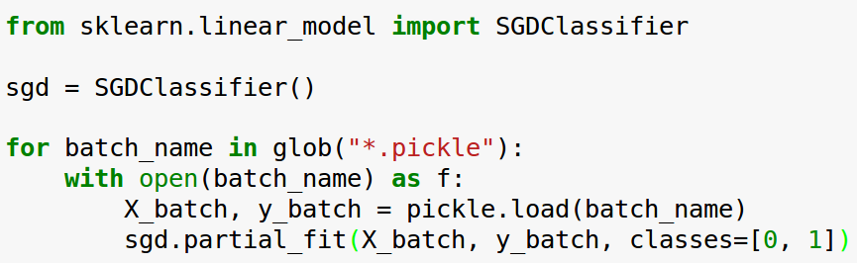
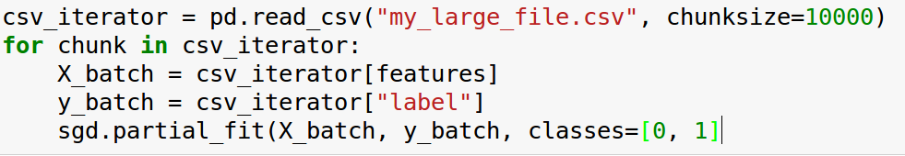
Linear Classification

Slide 60
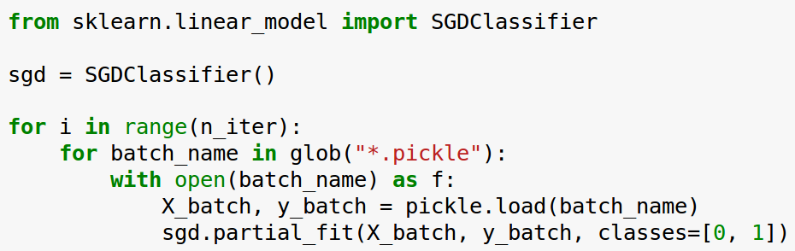
Linear Classification

Slide 61
Text Classification: Bag Of Word
“This is how you get ants.”
tokenizer
['this', 'is', 'how', 'you', 'get', 'ants']
Build a vocabulary over all documents
['aardvak', 'amsterdam', 'ants', ... 'you', 'your', 'zyxst']
Sparse matrix encoding
aardvak
ants
get
you
zyxst
[0, …, 0, 1, 0, … , 0, 1 , 0, …, 0, 1, 0, …., 0 ]

Slide 62
Text Classification: Hashing Trick
“This is how you get ants.”
tokenizer
['this', 'is', 'how', 'you', 'get', 'ants']
hashing
[hash('this'), hash('is'), hash('how'), hash('you'), hash('get'), hash('ants')]
= [832412, 223788, 366226, 81185, 835749, 173092]
Sparse matrix encoding
aardvak
ants
get
you
zyxst
[0, …, 0, 1, 0, … , 0, 1 , 0, …, 0, 1, 0, …., 0 ]

Slide 63
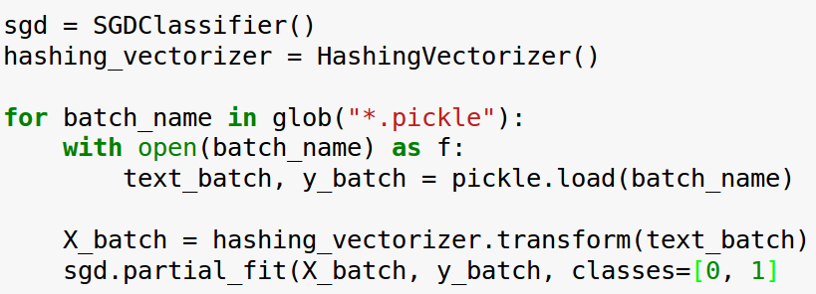
Text Classification: Hashing Trick

Slide 64
Supported Algorithms
All SGDClassifier derivatives
Naive Bayes
MinibatchKMeans
IncrementalPCA
MiniBatchDictionaryLearning

Slide 65
http://scikit-learn.org/

Slide 66
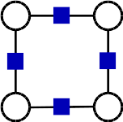
PyStruct
Structured Prediction in Python
Andreas Mueller (NYU Center for Data Science, scikit-learn)

Slide 67
Structured Prediction

Slide 68
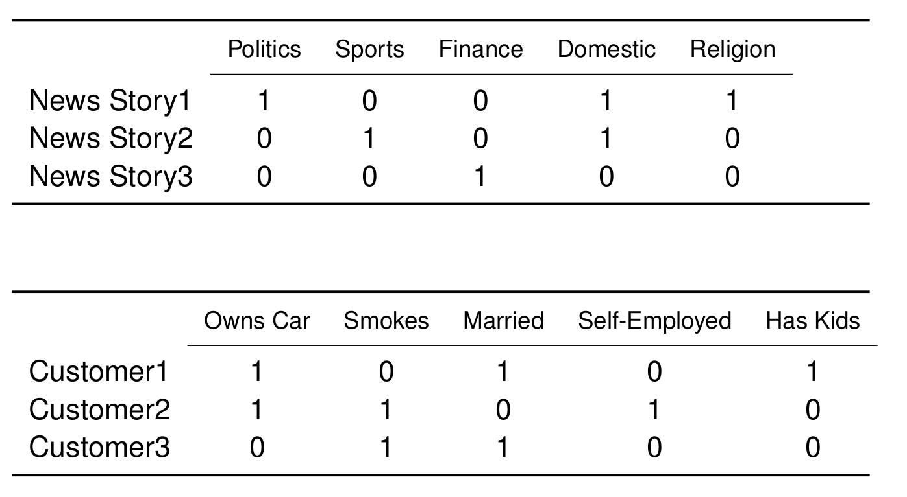
Applications: Multi-Label Classification

Slide 69
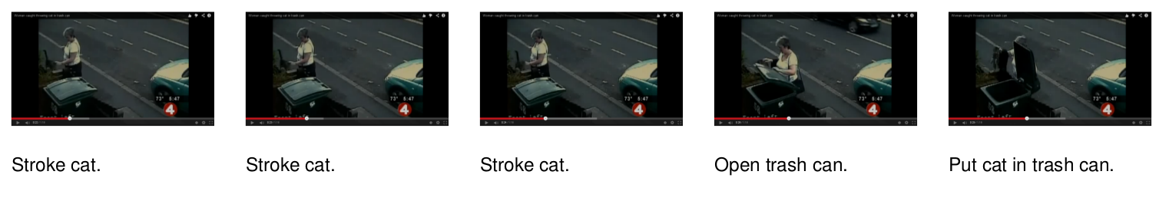
Applications: Sequence Tagging

Slide 70
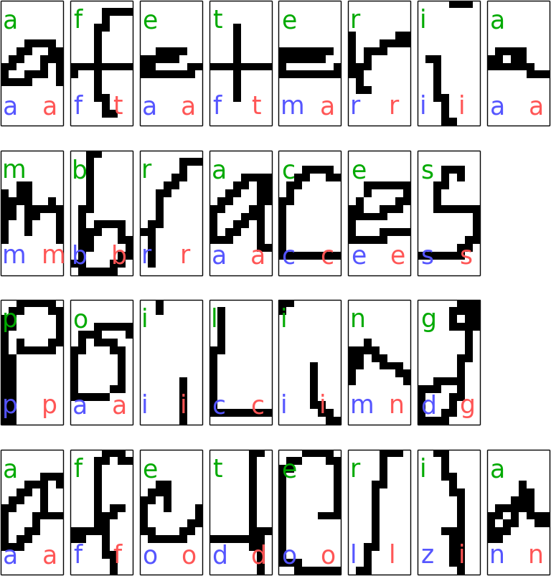
Sequence Tagging example
model = ChainCRF(inference="max_product")
ssvm = OneSlackSSVM(model=model, C=.1)
ssvm.fit(X_train, y_train)

Slide 71
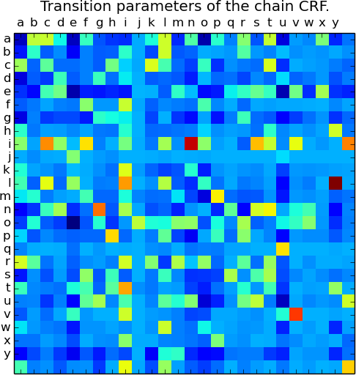
Sequence Tagging example
model = ChainCRF()
ssvm = OneSlackSSVM(model=model, C=.1)
ssvm.fit(X_train, y_train)

Slide 72
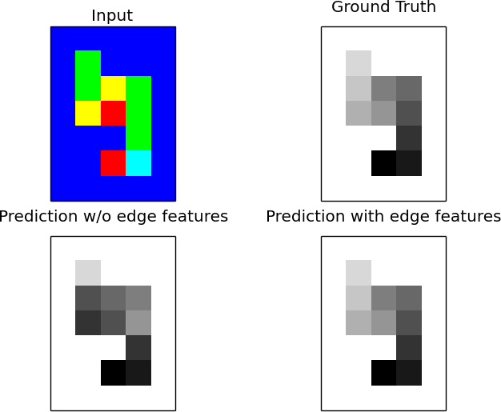
Grid Graphs: Snakes

Slide 73




Thank you for your attention.
@t3kcit
@amueller
importamueller@gmail.com
http://amueller.github.io

